Slide 1
Autonomous UAV
Group Members: Osman Ali Mian 11k-2123
Mohsin Mansoor Kerai 11k-2219
Mahak Mohbat Ali 11k-2197
Hira Farman 11k-2205

Slide 2
Possible Applications
Autonomous Flying Robots that can carry do the job of portable things
Things that may be needed for specific time only.
For example
Temporary Camera’s : For Re-inforced security
Temporary Light Bulbs: For any casual event
Temporary WiFi Hotspots

Slide 3
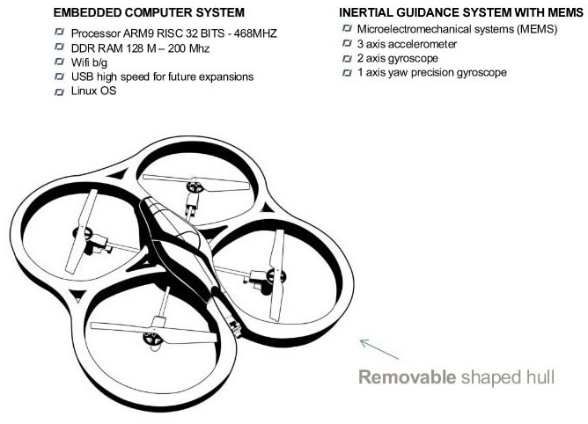
The Drone Specs

Slide 4
Problem Statement
Make The Drone Autonomous Such That
It Can Fly From Point A to point B (FYP-1)
Not Hit Any Obstacles In The Process (FYP-1)
Identify a “Safe Spot” and Park Itself There (FYP-2)

Slide 5
Solution Proposed
Use a PD control to issue commands to the drone to move from point A to point B
Use an Ultrasonic Depth Sensor facing the same direction as the Drone to detect its distance from any obstacle
Use of Computer Vision to Process In Coming Image for Safe Place Detection Purpose. (Not For This Time)

Slide 6
Solution Break Up
In order to achieve the solution some steps need to be followed:
This Time
Set up Robot Operating System Environment to Issue navigation commands to the drone
Use Arduino equipped with a depth sensor and mount it on drone
Next Time
Process the raw image data being received from drone
Integrate drone navigation with computer vision

Slide 7
FYP-I
Drone Should Take Off, and Travel to a given co-ordinate
The Drone Should not hit any obstacles that come in its direction of facing (currently 1 sensor only)
Don’t let the drone move forward if there is an obstacle in front of it

Slide 8
Progress

Slide 9
Experiment 1
Analyze the amount of weight the drone can carry
Needed to see feasibility of attaching an Arduino to the drone

Slide 10
Experiment 2: Manual Navigation
Controlling AR Drone using open loop commands
Test Runs Included:
Make a circle
Make a square
Make the letter “Z”
To see any delays in command issue-execution cycle

Slide 11
Experiment 3: The Cockpit
Navigation experiments using video feed from the drone
Previous experiments were observing drone from the outside
Used video feed from drone where the pilot could observe the world only through drones camera.
Helped analyze the quality of image received over time

Slide 12
Experiment 4: The Autonomous Flight
PD Control Was Implemented to Navigate the drone (Video Included)
Send the drone from point [0,0,0] in the world to the following points
[100,0,0]
[150,80,0]
[200,200,0]
All Readings are in cm
Erroneous in terms of bearing, due to abnormal yaw updates in the drone
Configuring the Proportional and Derivative gains was difficult.

Slide 13
Experiment 5: Detect Obstacles
Use SRF08 Sonic Sensor mounted on an Arduino.
Mount Arduino on the drone (Not done)
Take readings from Arduino to decide if drone should go forward
Stop the drone if there is an obstacle

Slide 14
Experiment 6: Outdoor Object Recognition
A warm-up for FYP2
Object recognition Algorithm, written using OpenCV . Detecting Doors and Windows
Extracts HOG features and trains a non-linear SVM classifier.

Slide 15
Cost Incurred So Far
50,000 PKR for the drone
2,500 PKR Arduino
400 PKR Sonar Depth Sensor
8000 PKR Arduino WiFi Module (Not Yet Bought)

Slide 16
Improvements Needed
The Ultrasonic Sensor and Drone are not yet working in collaboration
Main Obstacles:
Cost (Main reason)
Extra Time Spent on PD Control (Inconsistent Documentation Online)
Currently The Drone Responds to the readings from Ultrasonic sensor, but the sensor is only “virtually” on the drone
Mount 1 depth sensor perpendicular to the current sensor for sideways obstacles as well

Slide 17
Future Work (FYP 2)
Integrate computer vision with navigation: apply object recognition technique to the images received through drones camera
Find the safest place in those pictures of the scene
Fly to the safest place found and park itself.

Slide 18
Thankyou! ☺

